Slide 1
SVD and PCA:
A tale of mayhem and intrigue….
Heather Michaud
Drew Guarnera

Slide 2
Singular Value Decomposition (SVD)
Process for taking any M x N matrix and decomposing the results into three matrices
An input data matrix is decomposed into a series of matrices

Slide 3
Image Compression
Basic Process
Compute SVD for a pgm image
Determine a rank approximation for the image
A rank approximation involves preserving values from the Σ matrix based on the rank number.
Example: Rank 10 would save the highest 10 values from Σ matrix
Trim columns in U and rows in V^{T}
Store results into binary file using the float data type (4 bytes per numerical value)

Slide 4
Implementation Details
SVD library:
Eigen 3
Header based library for C++
Matrix in memory storage:
Eigen objects
Binary Translation:
reinterpret_cast<char*>
push data to vector, and write to file with ofstream in binary mode

Slide 5
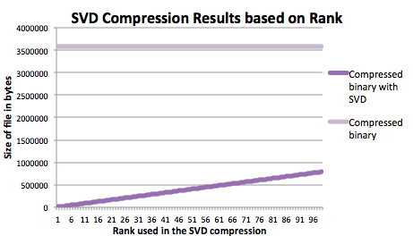
Image Compression

Slide 6


Image Compression
500
300
200
100
50
20
3

Slide 7
Principal Component Analysis (PCA)
Assisted by SVD
A statistical method that seeks to find a rotation of your data
Reduces the dimensionality of high dimensional data to better visualize information

Slide 8
Data Analysis with Git
What is Git?
Software Control Management System (Version Control)
Why is it important?
Offers a wide variety of flexibility for software development workflows.
It is gaining ground on other version controls systems such as SVN.

Slide 9
Data Collection
Custom designed tool
Collects data about diffs between commits
Features in the Dataset:
sha
files modified
hunks modified
lines modified
commit time
number of parents
author
committer

Slide 10
Features Selection
Files Modified
Number of files modified during any commit
Hunks Modified
Number of hunks are blocks made up of consecutively modified lines and contextual lines above and below the section
Lines Modified
Number of lines modified between two commits

Slide 11
Analyzed Repositories
Data-Driven Documents (D3)
Javascript library utilized for interactive data presentation.
Allows you to bind arbitrary data to a Document Object Model (DOM), and then apply data-driven transformations to the document.

Slide 12
Analyzed Repositories
Node.js
A platform built on Chrome's JavaScript runtime (V8) for easily building fast, scalable network applications.
Event-driven, non-blocking I/O model for lightweight and efficient, data-intensive real-time applications that can run across distributed devices.

Slide 13
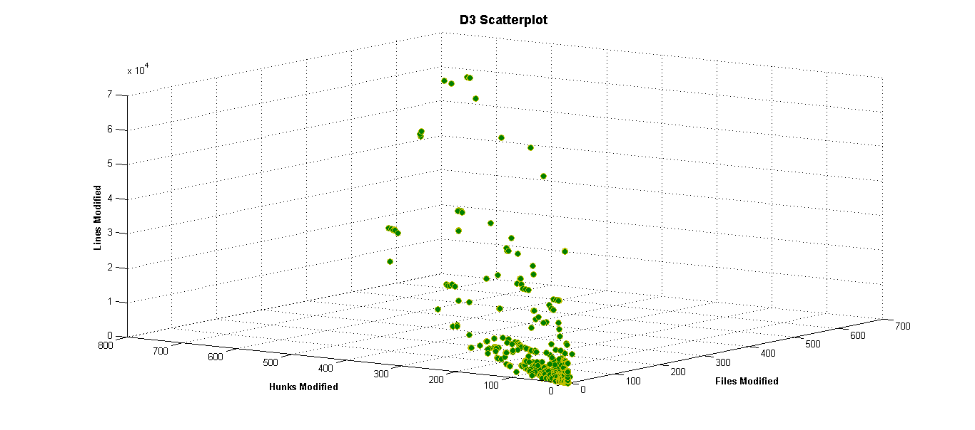
D3 Dataset with 3 Dimensions

Slide 14
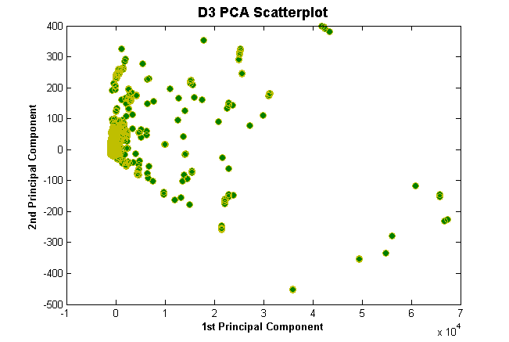
D3 Dataset After PCA

Slide 15
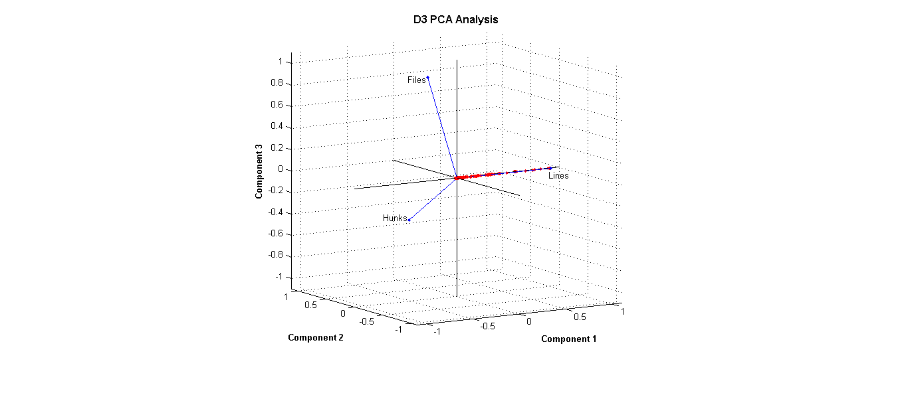
D3 Dataset After PCA

Slide 16
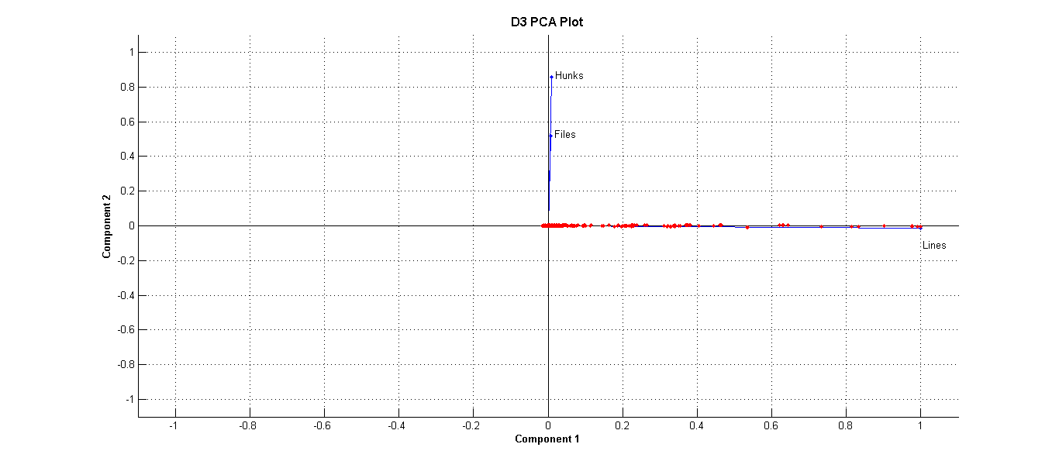
D3 Dataset After PCA

Slide 17
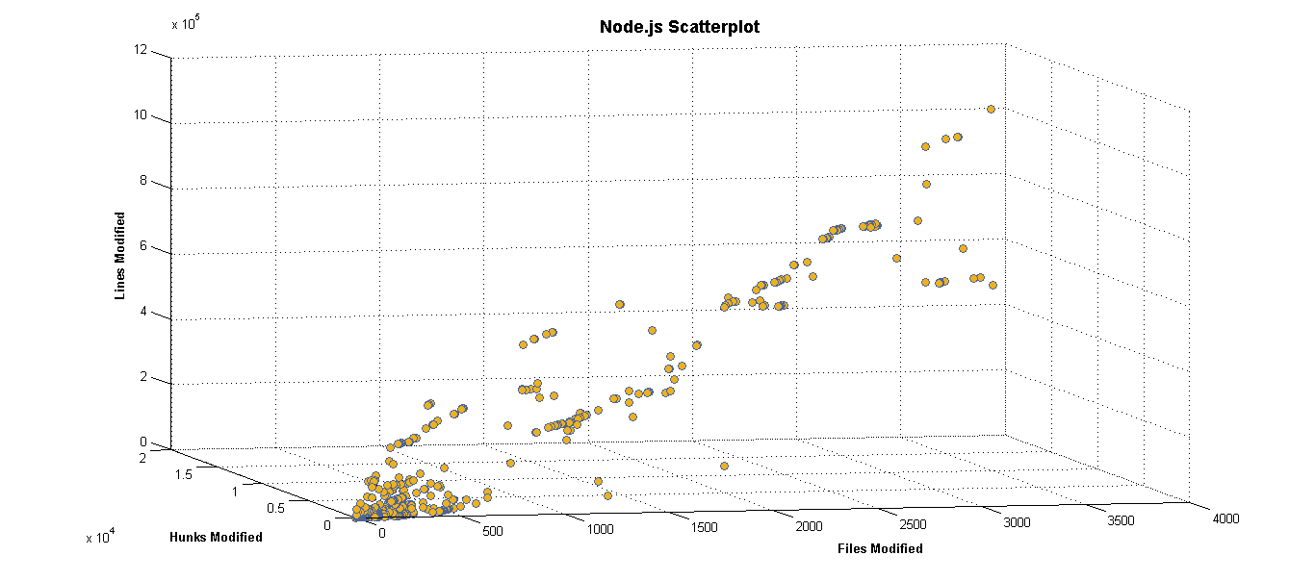
Node.js Dataset with 3 Dimensions

Slide 18
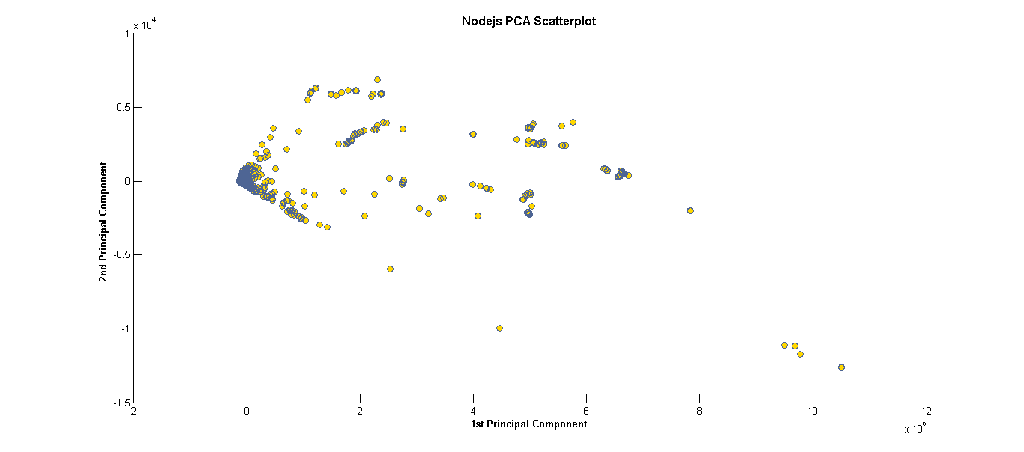
Node.js Dataset After PCA

Slide 19
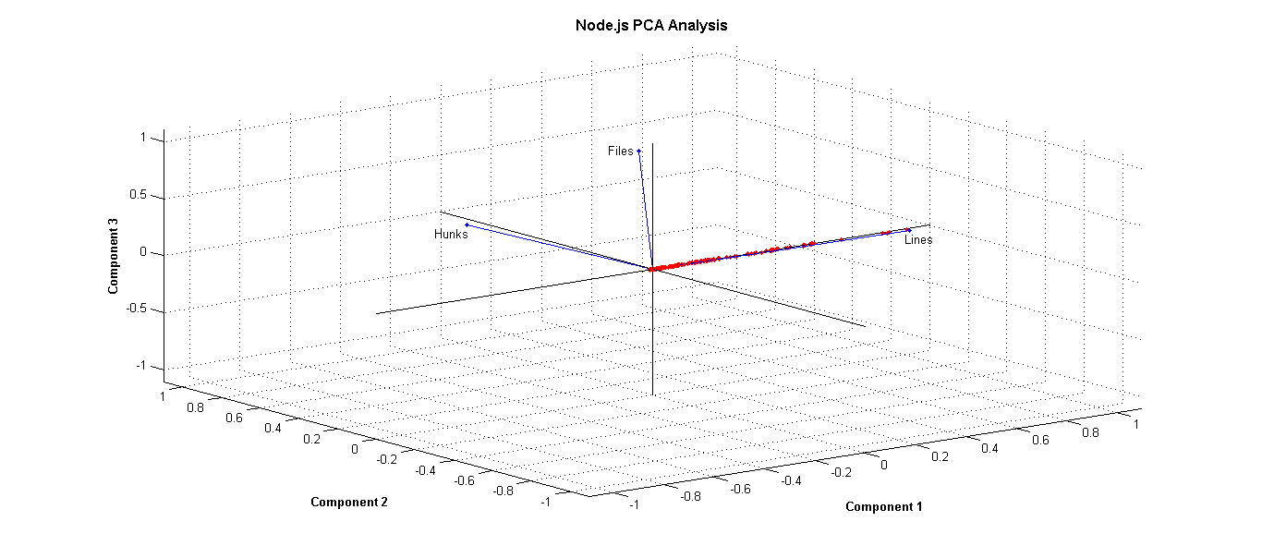
Node.js Dataset After PCA

Slide 20
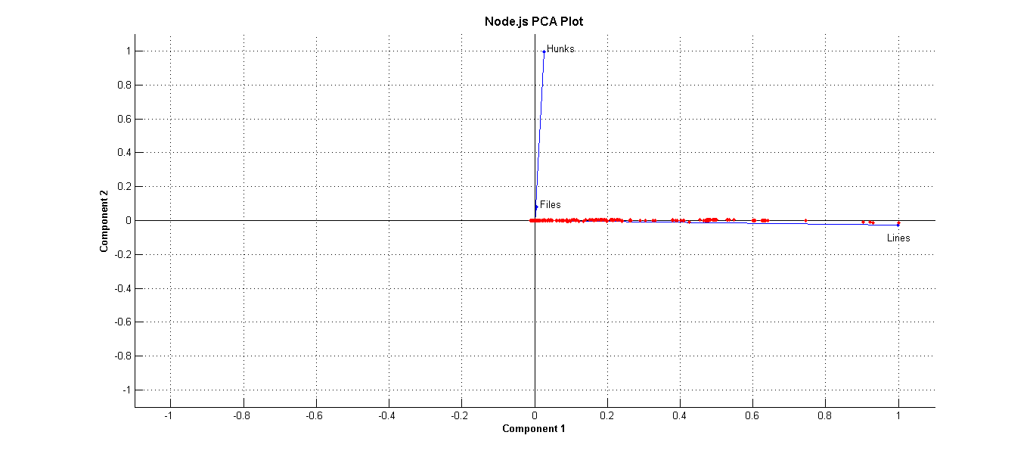
Node.js Dataset After PCA

